Slide 1
Student Attendance System
for Students & Teachers

Slide 2






Our team
Md Mehedi Hasan
Mahmuda Adeeba Tul Husna
Mehedi Hasan Pranto
21225103334
21225103357
21225103333
Abdullah Al Hil Baki
Mushfiqur Rahman
21225103341
21225103525

Slide 3
Table of contents
01
02
03
04
05
06
07
08
Abstract
Problem Statement
Objectives
Literature Review
System Design
Implementation
Technology Stack
Conclusion

Slide 4
Abstract
The Student Attendance System is a web-based application designed to simplify and digitize attendance management. It features three panels: Admin, Teacher, and Student. Admins can manage classes, teachers, and students. Teachers can track and export attendance, while students can view their attendance records, ensuring transparency and efficiency.

Slide 5
Problem Statement
Traditional attendance systems are time-consuming, prone to human errors, and lack transparency. Students often remain unaware of their attendance status. Educational institutions need a centralized, efficient system to automate attendance tracking, reduce errors, and provide easy access for stakeholders.

Slide 6
Objectives
Develop a centralized attendance management system.
Allow admins to manage classes, teachers, and students effectively.
Enable teachers to record, view, and export attendance data.
Provide students with real-time access to their attendance records.

Slide 7
Literatur Review
System A
System B
Manual, paper-based attendance processes that are inefficient and error-prone.
Software solutions that provide functionalities for admins and teachers but do not offer students access to their attendance records, reducing transparency.

Slide 8
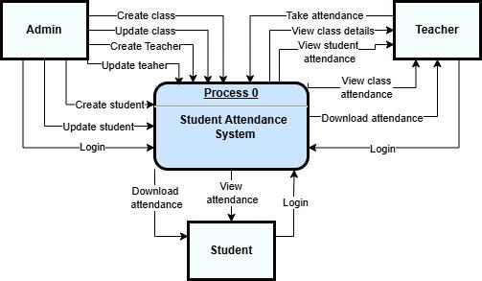
System Design
Context Level Data Flow Diagram

Slide 9
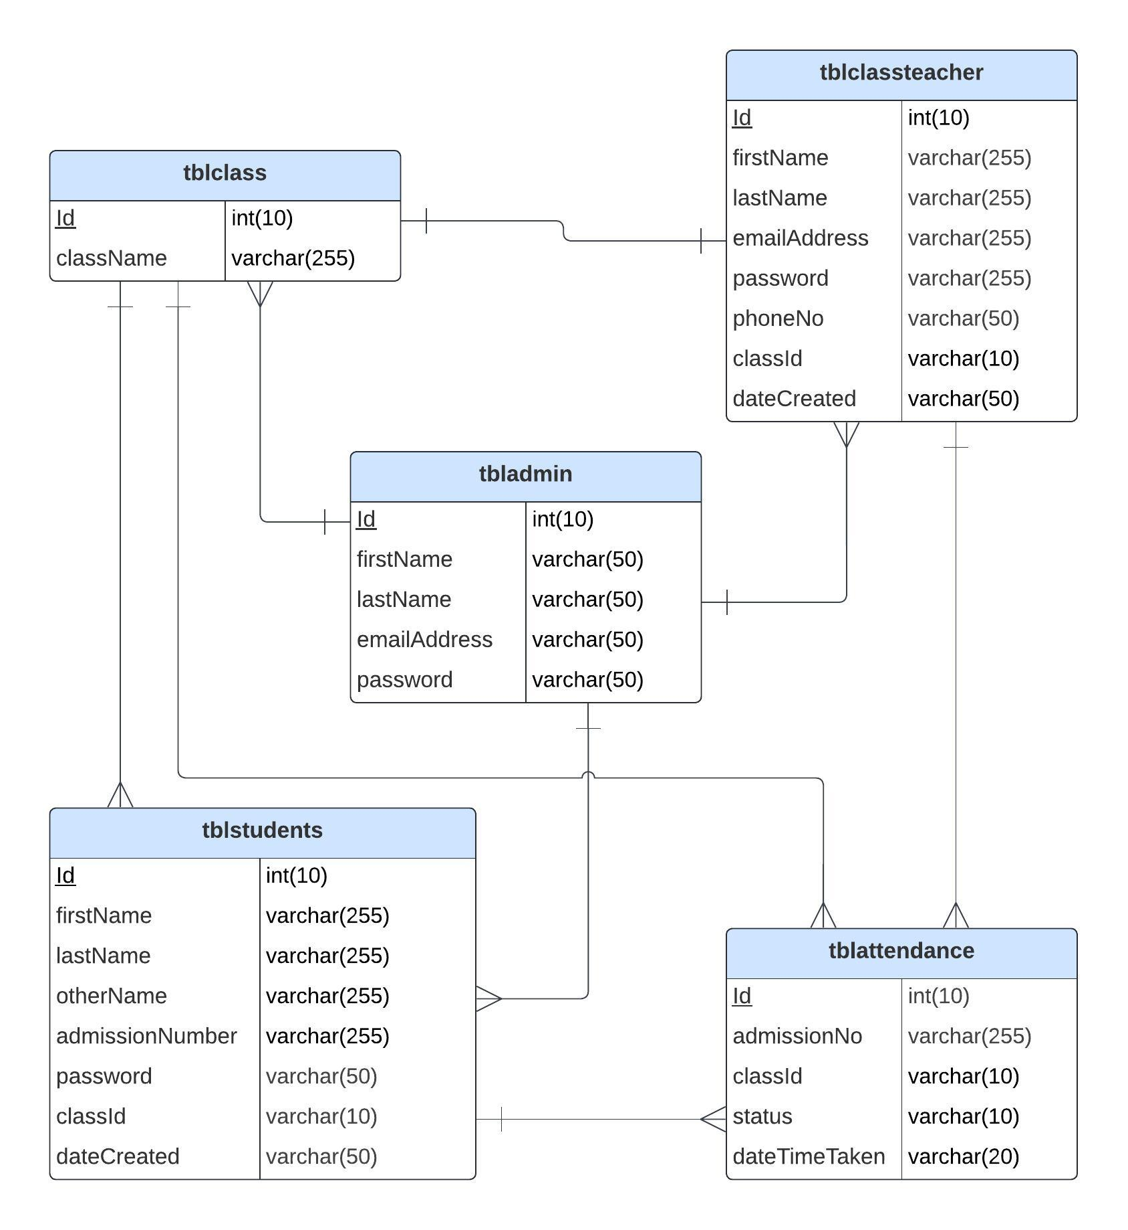
ER Diagram

Slide 10
Implementation
Key relationships in the database
tbladmin is independent but oversees the management of all other tables.
tblclass is connected to tblclassteacher (each teacher is assigned to one class) and tblstudents (students belong to one class).
tblstudents and tblattendance are linked by the admission number to track attendance for individual students.
Database is fragmented using class, and partitioned into four databases (sas_six, sas_seven, sas_eight, sas_other) to create distributed databases.

Slide 11
Student Attendance System UI

Slide 12
Admin Panel

Slide 13
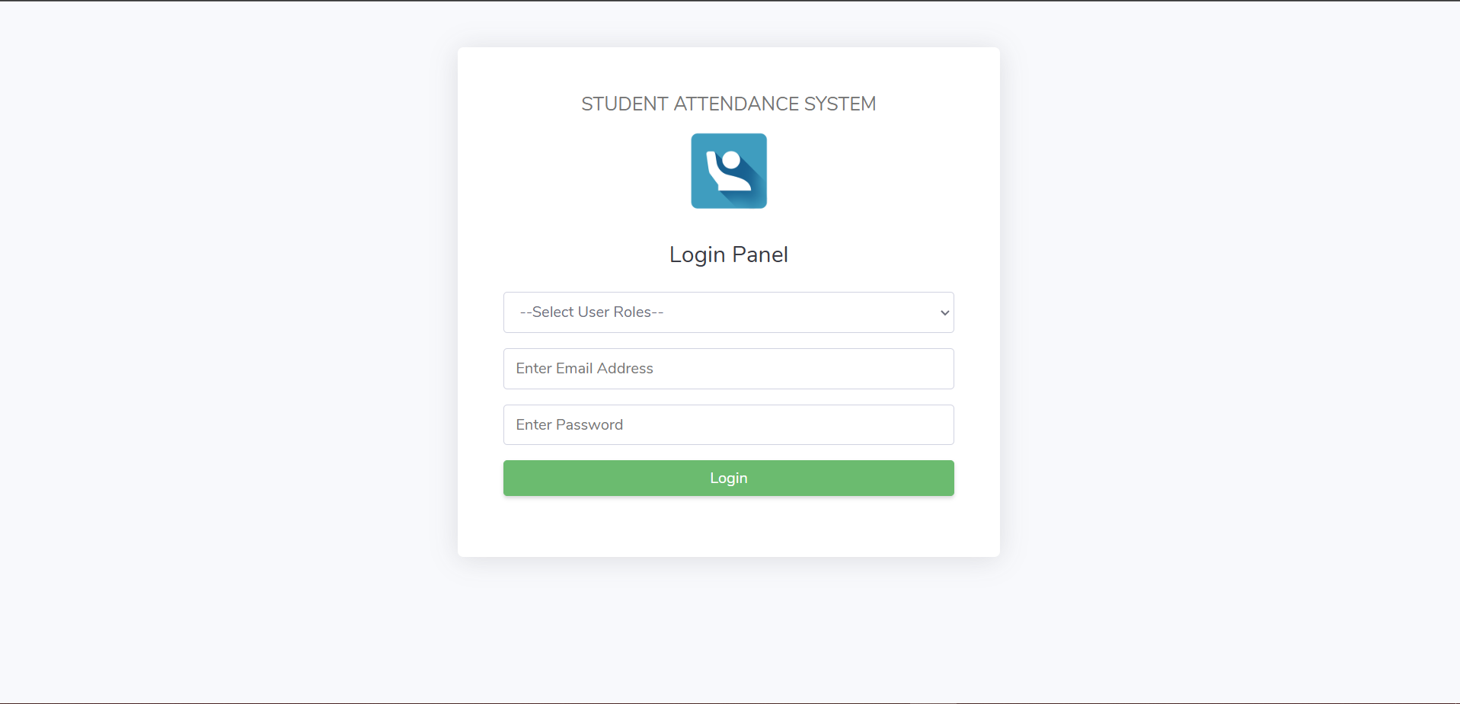
ER Diagram
Login Page

Slide 14
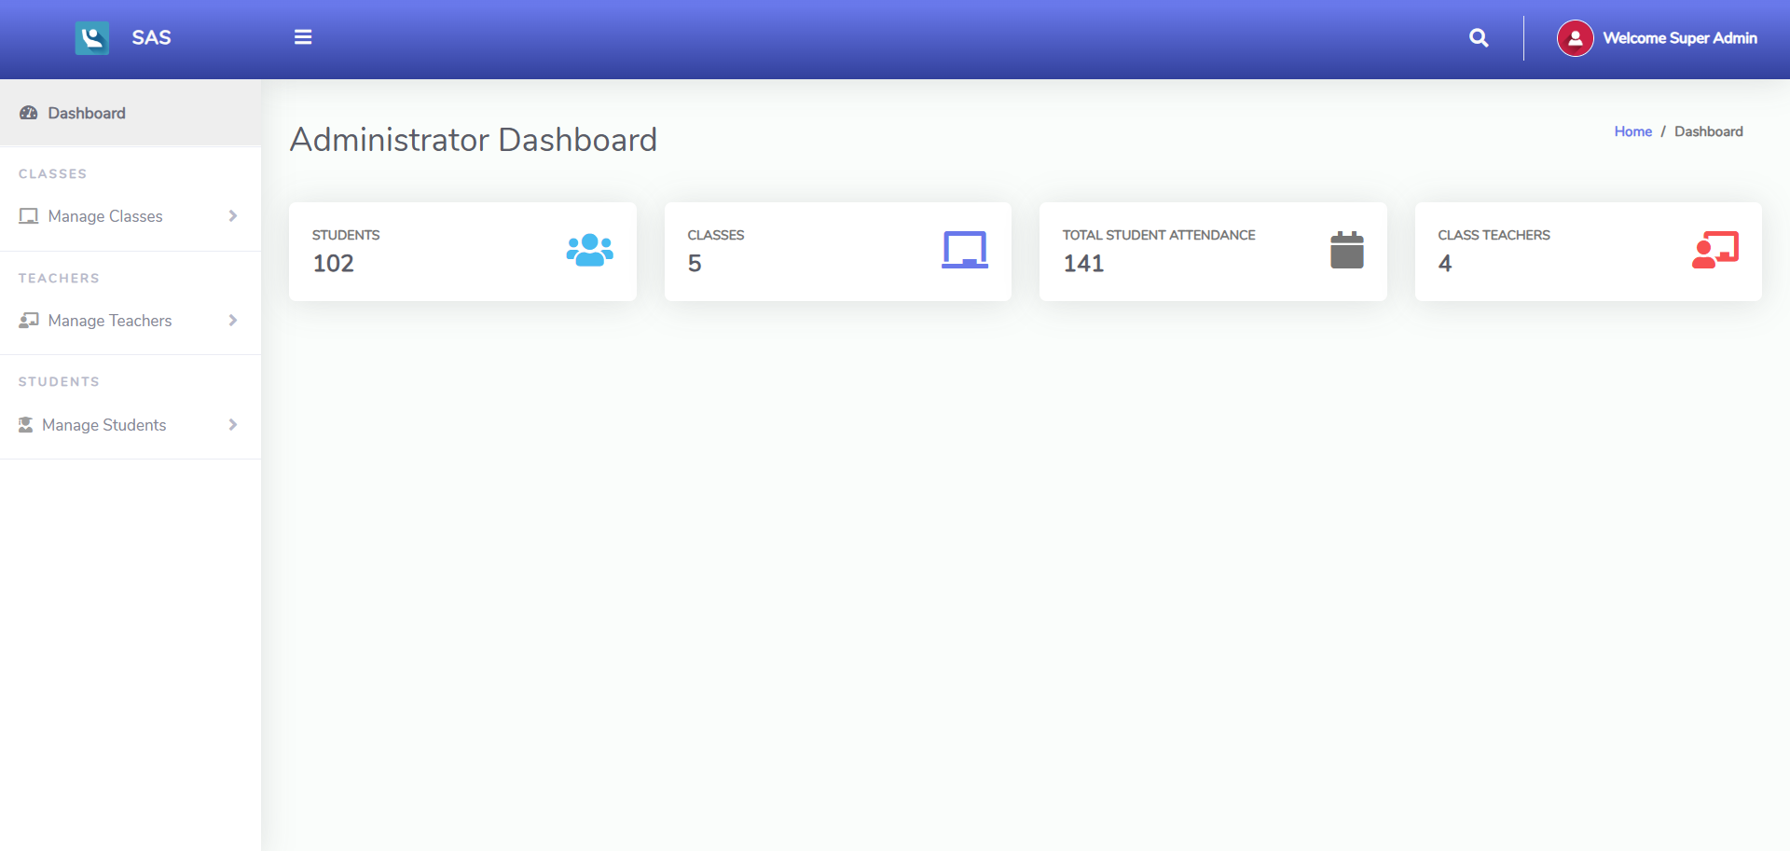
Dashboard

Slide 15
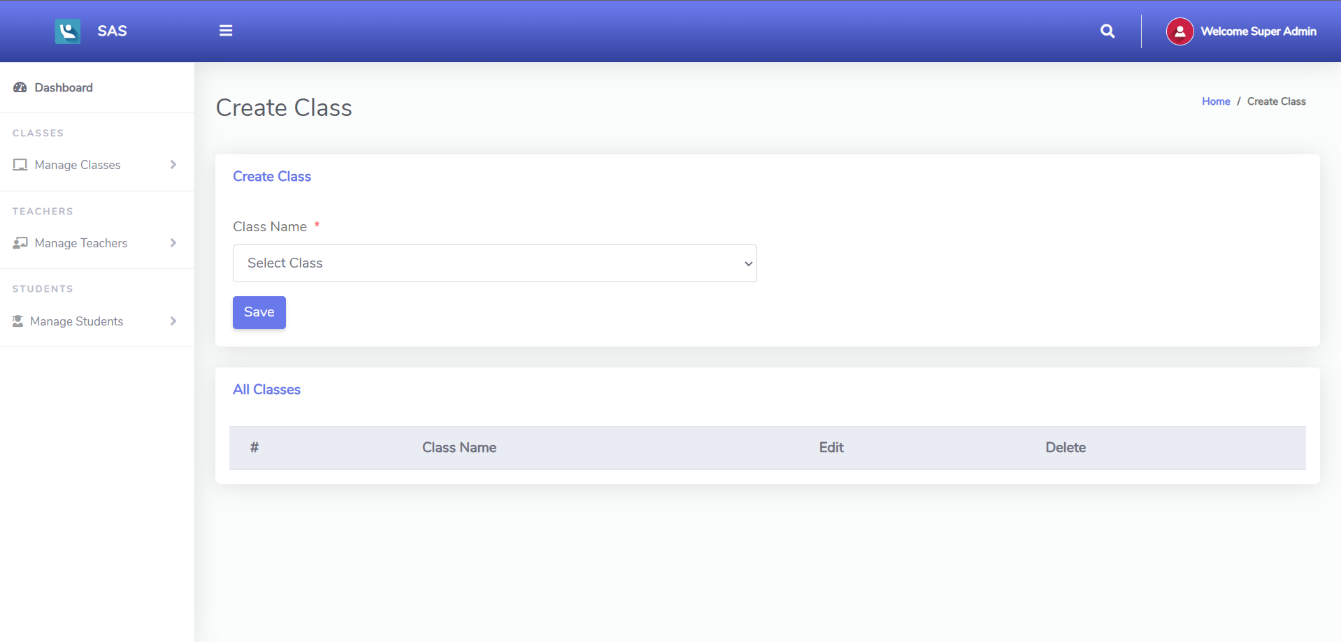
Create Class

Slide 16
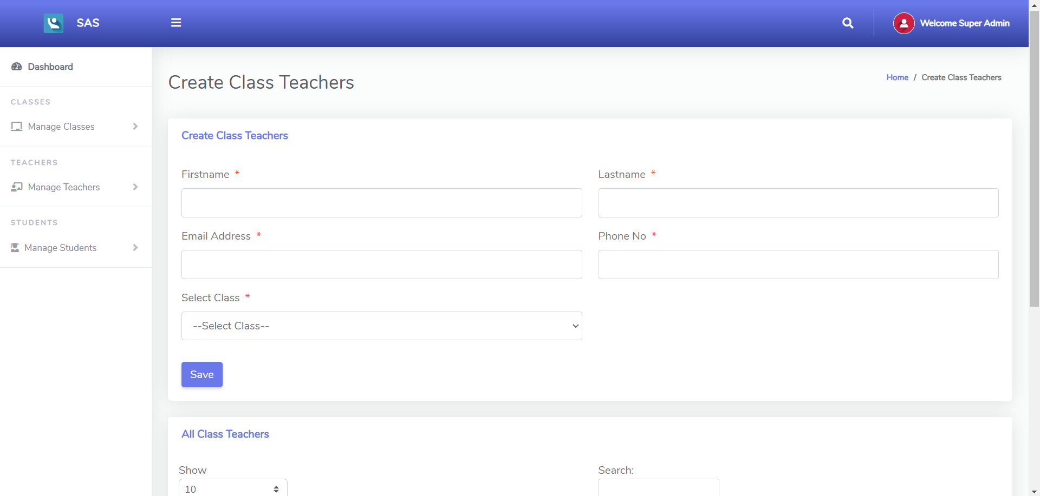
Create Class Teachers

Slide 17
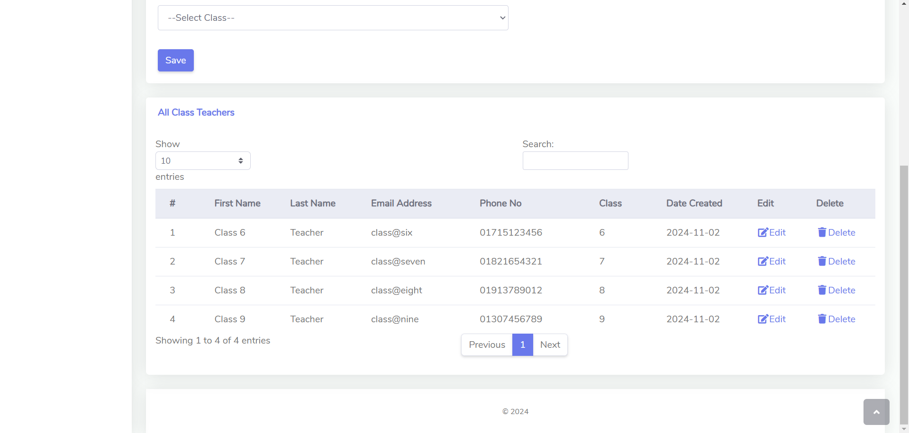
View Class Teachers

Slide 18
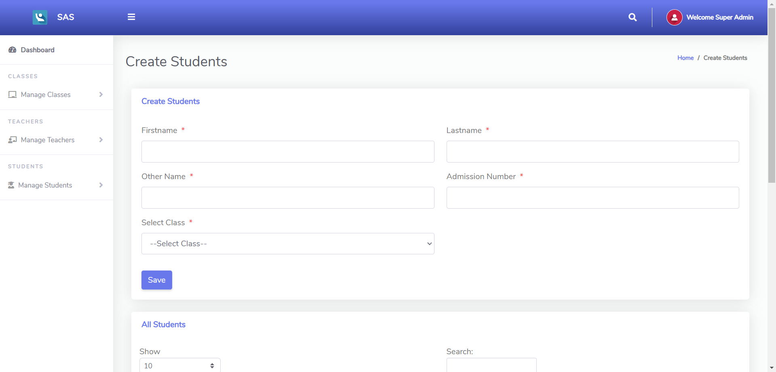
Create Students

Slide 19
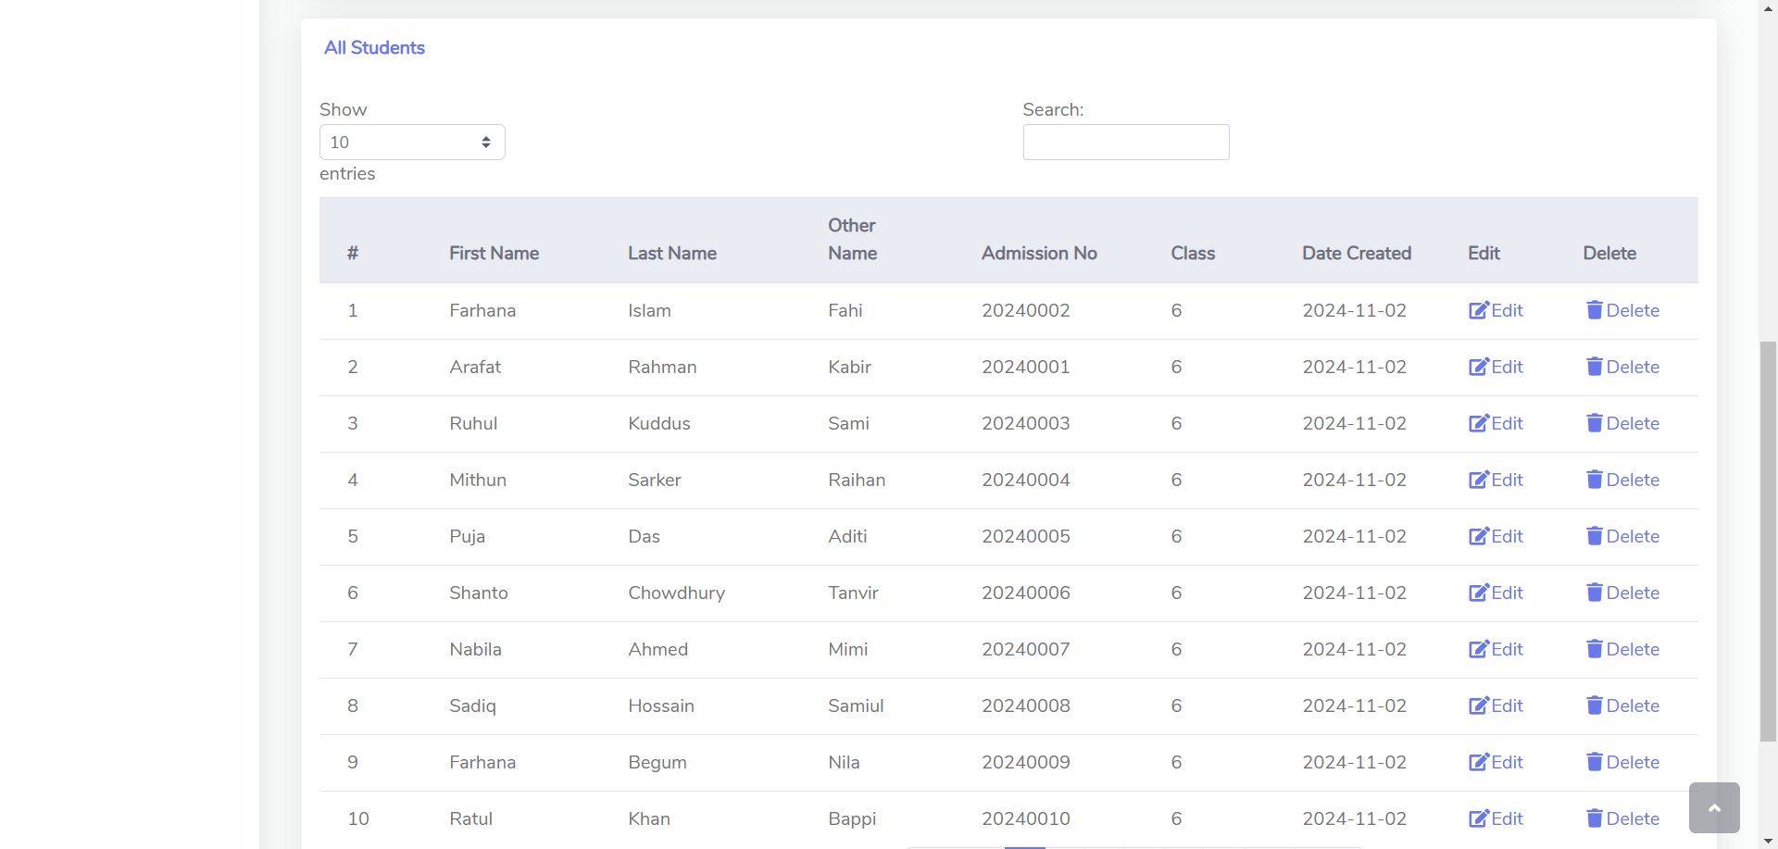
View Students

Slide 20
Teachers Panel

Slide 21
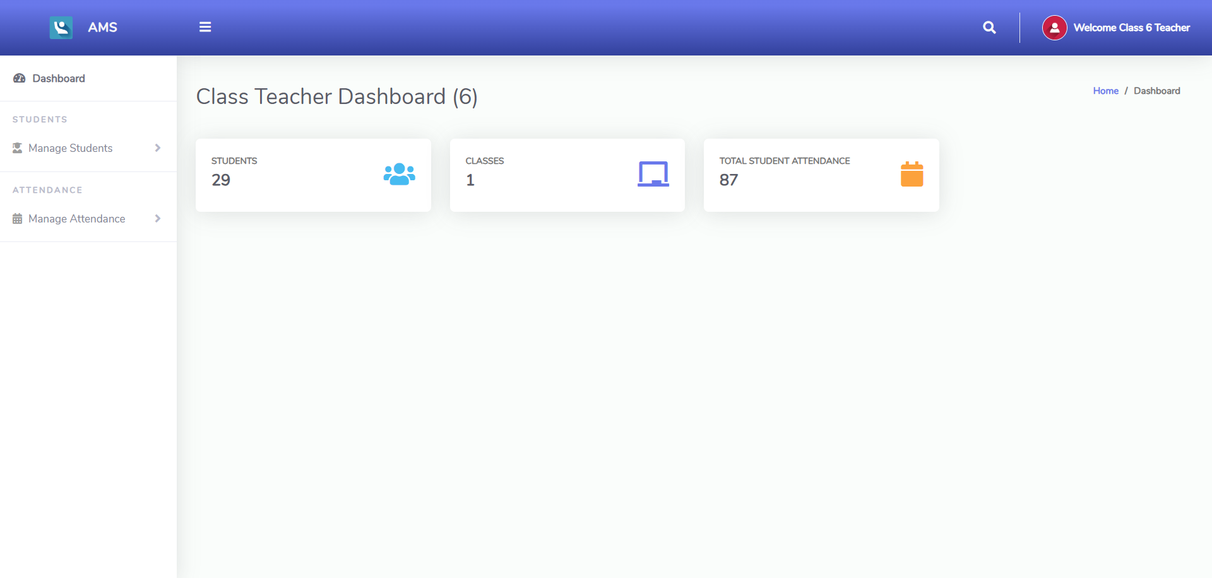
Dashboard

Slide 22
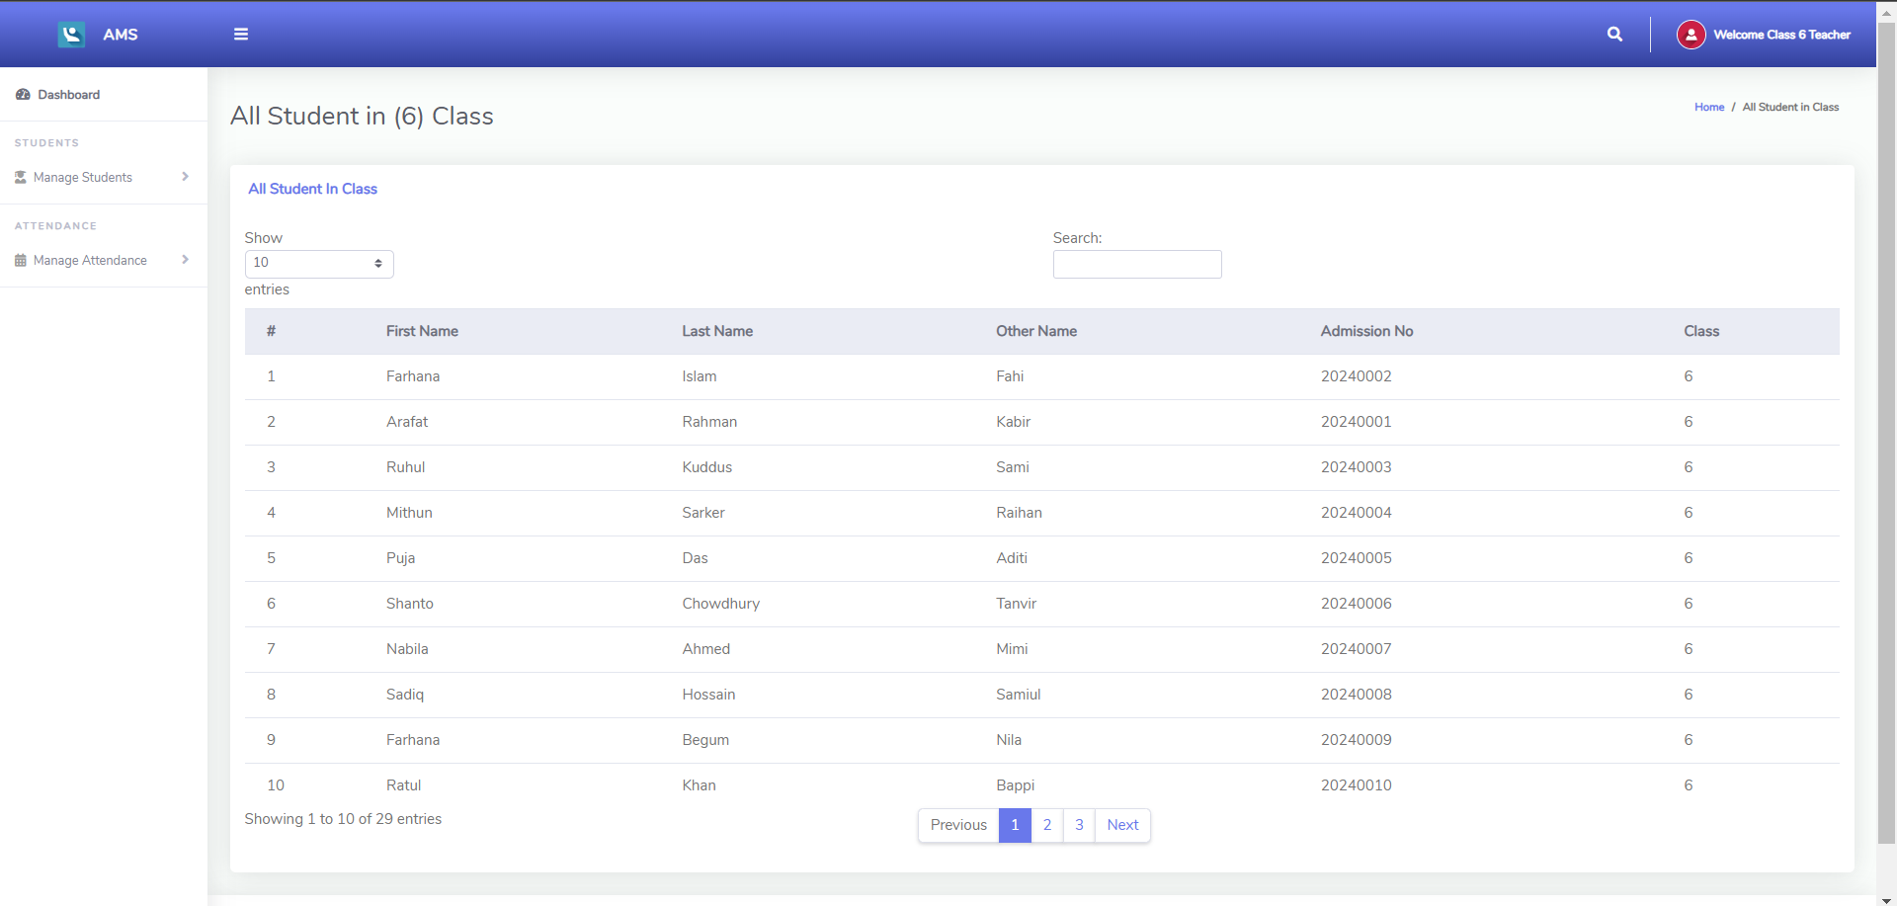
View Class Students

Slide 23
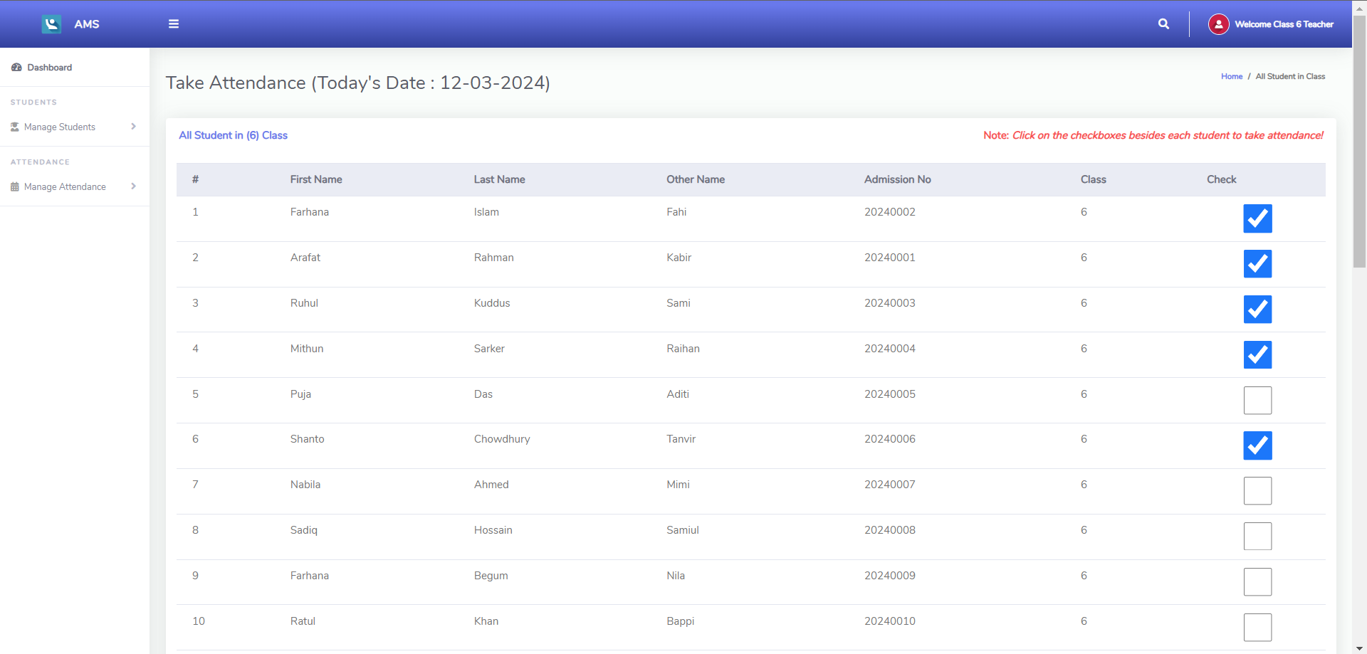
Take Attendance

Slide 24
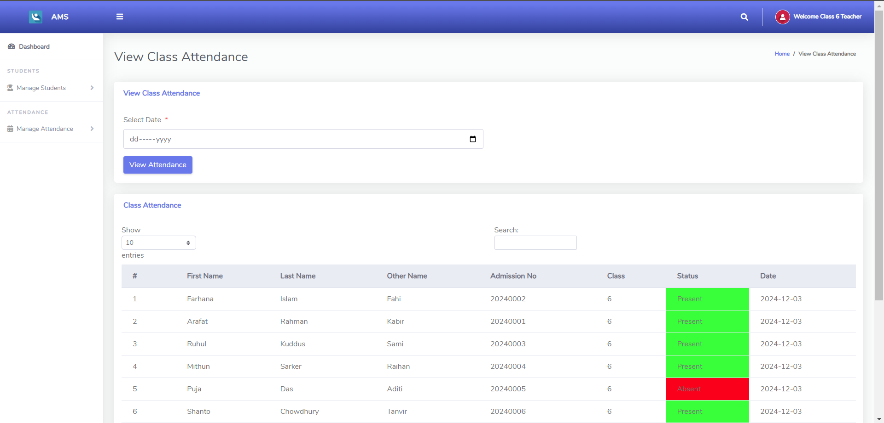
View Class Attendance

Slide 25
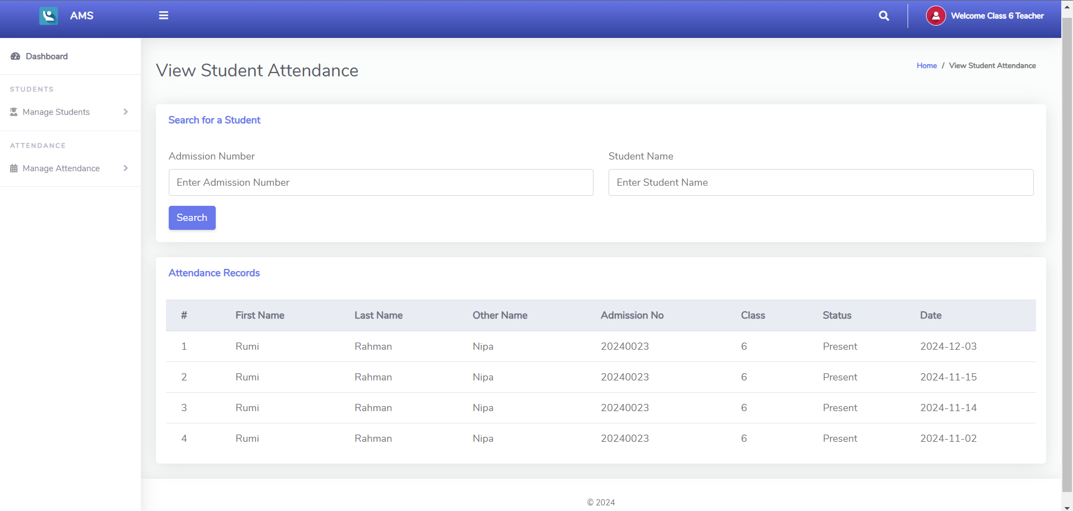
View Student Attendance

Slide 26
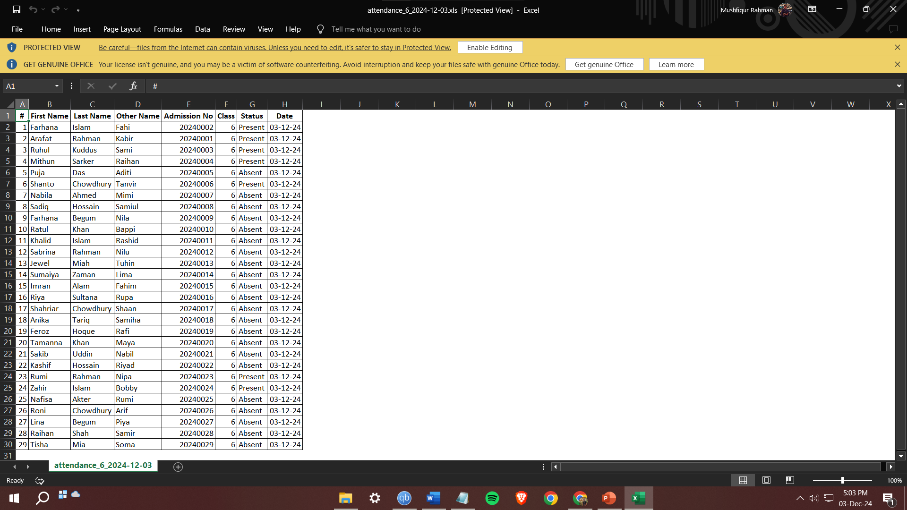
Download Attendance

Slide 27
Students Panel

Slide 28
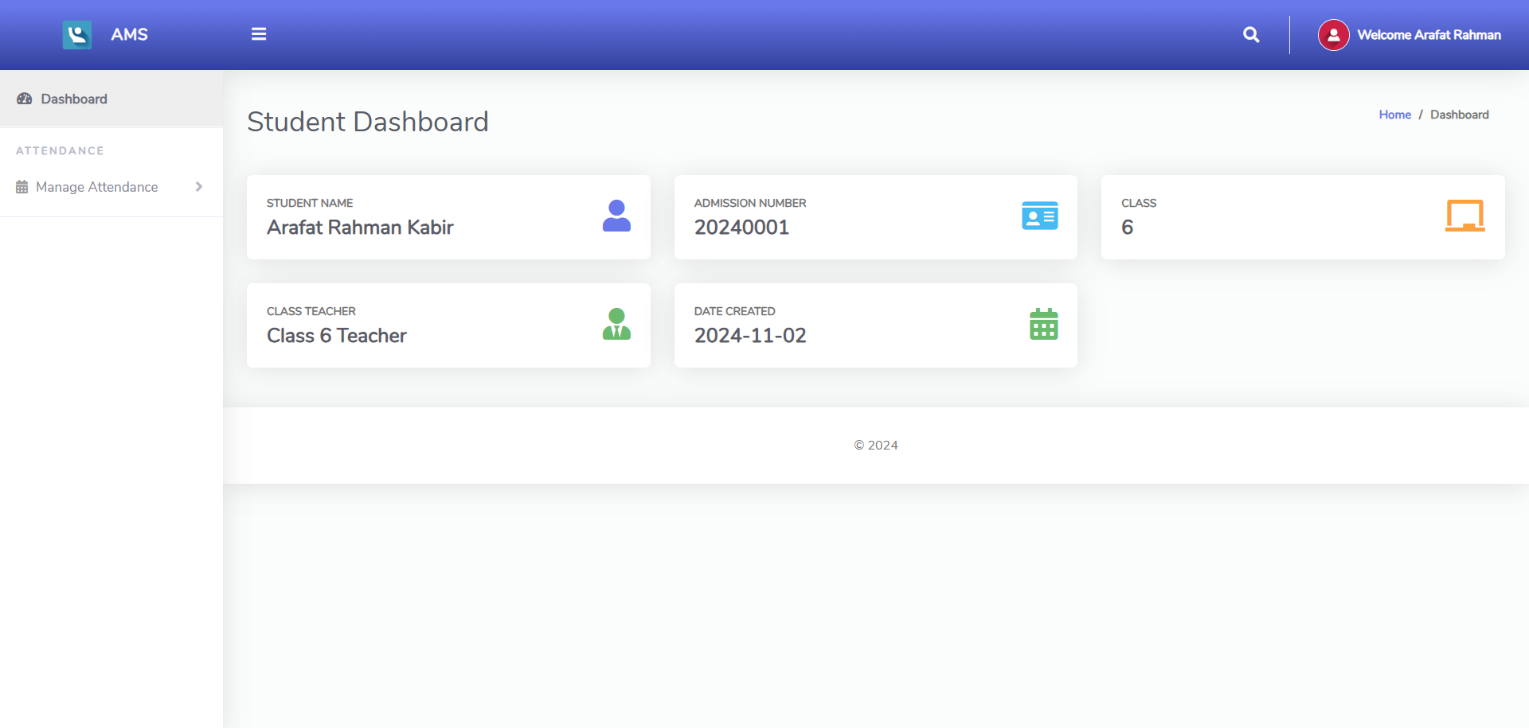
Dashboard

Slide 29
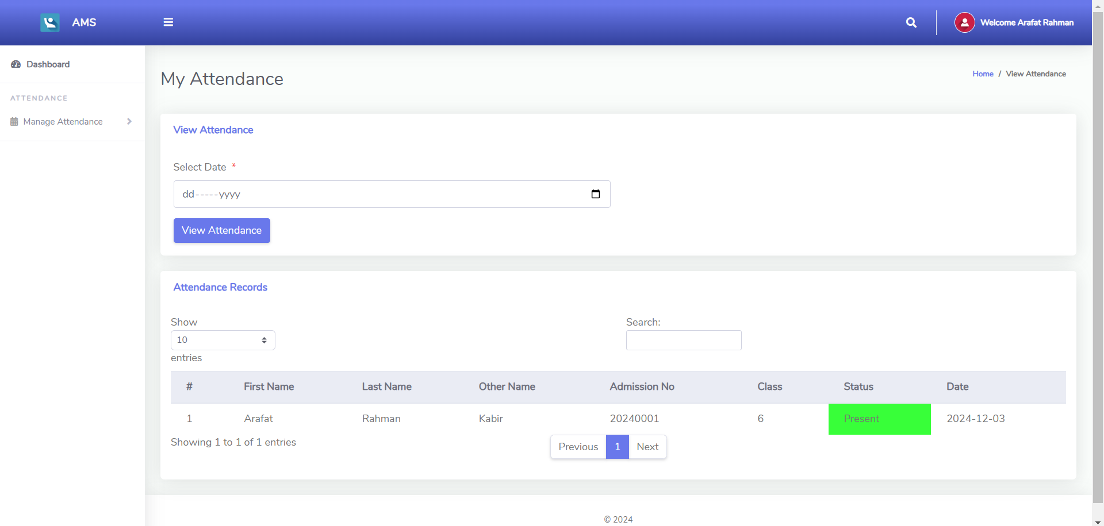
View Attendance

Slide 30
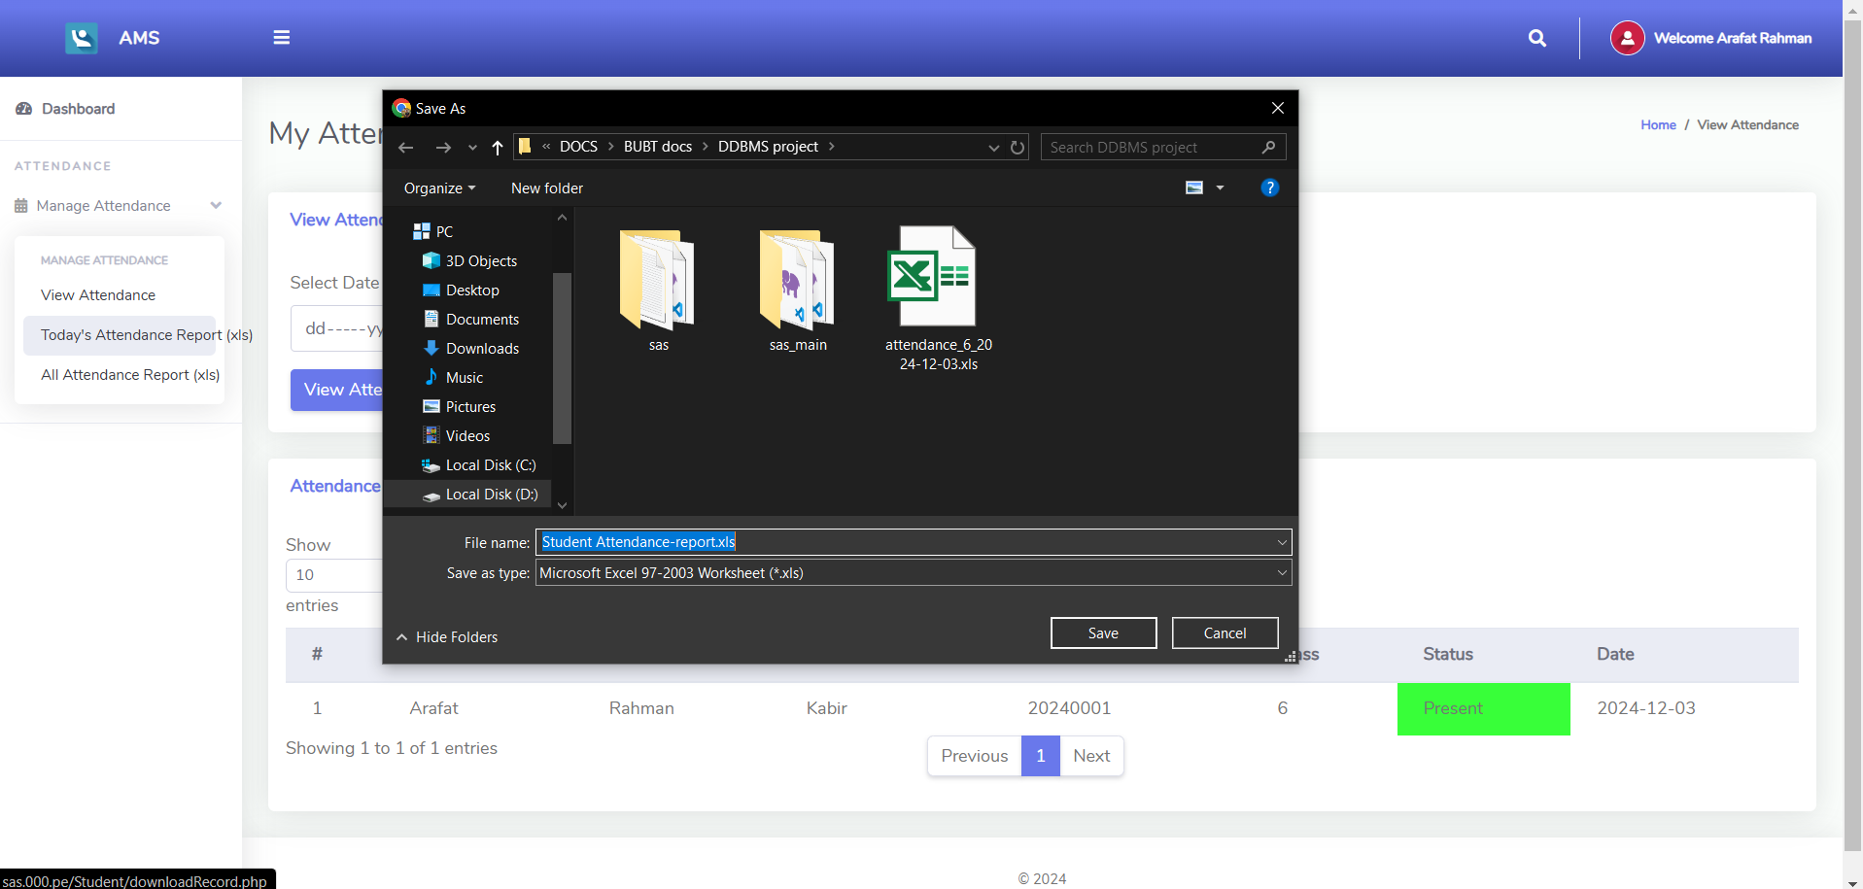
Download Attendance

Slide 31
Special Features
Student Panel: Unique feature allowing students to log in and view their attendance in real time.
Downloadable Reports: Teachers can export attendance records as Excel files for reporting and record-keeping.

Slide 32





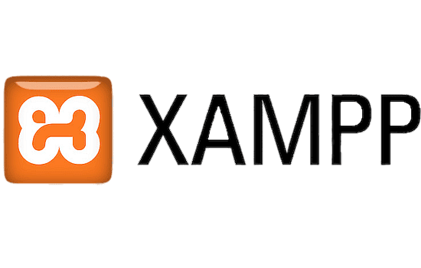

Technology Stack
FRONT END
BACK END
DATABASE
SOFTWARE

Slide 33
Conclusions
The Student Attendance System provides a scalable and efficient solution for managing attendance in educational institutions. It enhances transparency, minimizes manual errors, and ensures accessibility for admins, teachers, and students alike, making it an ideal tool for modern institutions.

Slide 34
Thanks!
Any Questions?

